Slide 1

Spatial Data Analysis in Power BI: From Beautiful Thematic Maps to R-based Models
Tony McGovern

Slide 2

Session Agenda
Understand How Power BI Can Help Your Workflow
See the Breadth of Spatial Analytics Available in Power BI

Slide 3


Tony McGovern
Hacker. Artist. Storyteller. Data lover.
Data Scientist
emdata.ai
github.com/tonmcg
twitter.com/tonmcg
Notes:
Data Scientist at emdata
We love Power BI helps us easily build impactful data applications that we allow us to scale at a fraction of the time, energy, and cost
And we love working with organizations that are making a difference in the world -- for us Power BI is the way for everyone to do more, better

Slide 4

How Power BI Can Help Your Workflow

Slide 5
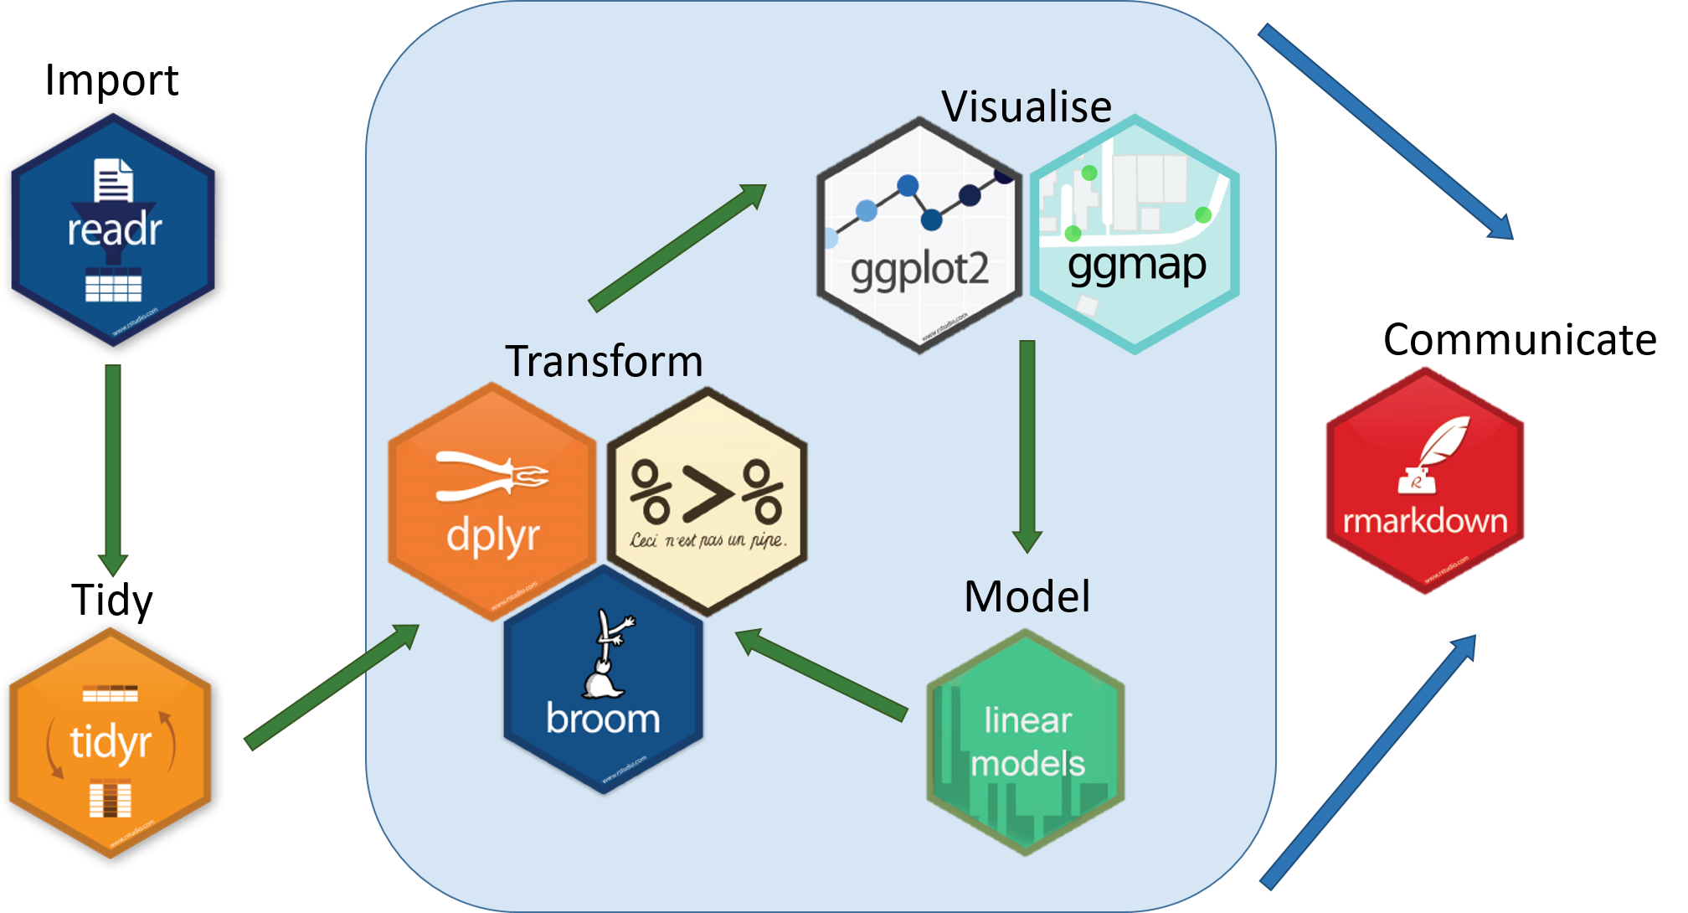
Simple Spatial Data Workflow in R
Image courtesy of Coding Club https://ourcodingclub.github.io/2017/03/20/seecc.html

Slide 6
How Can Power BI Help?
Image courtesy of Coding Club https://ourcodingclub.github.io/2017/03/20/seecc.html
Notes:
What Does Power BI Do Exceptionally Well?
Data Connectivity & Ingestion
Access data stored in hundreds of data sources through a clickable interface
Data Preparation
Allows users to apply over 350 different data transformations by previewing data and selecting transformations in the user interface.
Data transformation are consistent across all data sources and steps are recorded so users see a history of transformations
Data Query Extensions
Power Query comes with its own highly-intuitive data mashup language that can be customized

Slide 7
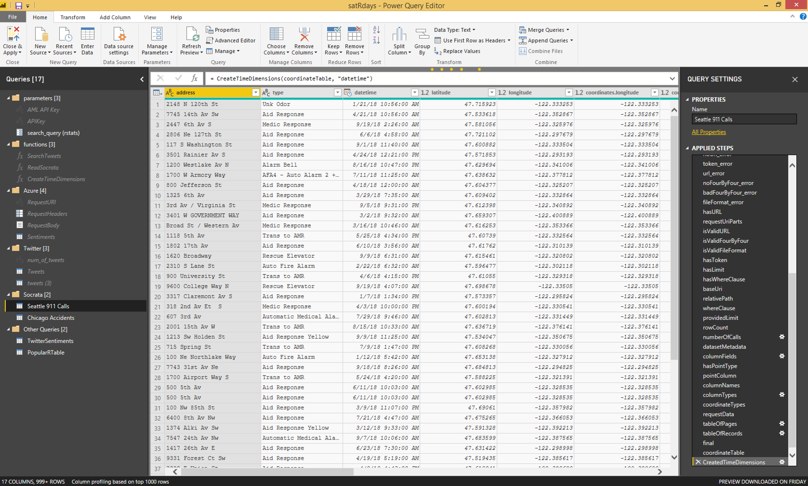
Connect, Prepare & Transform Data in Power BI

Slide 8
Breadth of Spatial Analytics Available in Power BI

Slide 9
Heatmaps, Clustering, Circles

Slide 10
Custom Boundaries & Extrusions

Slide 11
2016 Presidential Election Results

Slide 12
ML Models in R, Azure, and Power BI

Slide 13
Resources
Getting Started with Power Query for Data Preparation https://powerbi.microsoft.com/en-us/blog/getting-started-with-power-query-part-i/
Using R in Power BI https://www.red-gate.com/simple-talk/sql/bi/power-bi-introduction-working-with-r-scripts-in-power-bi-desktop-part-3/
Mapbox Visual in Power BI https://www.mapbox.com/help/power-bi-choropleth-map/
2016 Presidential Election Results https://github.com/tonmcg/US_County_Level_Election_Results_08-16
Socrata Open Data API https://dev.socrata.com/
Rsocrata https://github.com/Chicago/RSocrata
ACLU’s What the District?! https://what-the-district.aclu.org/
Build Experiment in Azure Machine Learning Studio https://docs.microsoft.com/en-us/azure/machine-learning/studio/create-experiment
Using R in Azure Machine Learning Studio https://docs.microsoft.com/en-us/azure/machine-learning/studio/r-quickstart
Notes:
Use Power BI & R for your data preparation process
Create beautiful thematic maps in Power BI
Use out of the box analytics available in these visuals
Use a mix of R, Azure, and Power BI machine learning models

